Slide 1
CHANDIDAS MAHAVIDYALAYA
DEPARTMEANT OF GEOGRAPHY
Topic.- introduction of research methodology
Prof.- Indrajit Mandal

Slide 2
What is Research?
A careful investigation for new facts in any branch of knowledge
Redman and Mory: Research is a systematic effort to gain new knowledge

Slide 3
What is Research?
Clifford Woody: Research-
defining and redefining problems, formulating hypothesis/objectives;
collecting, organizing and evaluating data;
making deductions and reaching conclusions;
testing the conclusions to determine whether they fit the formulating hypothesis/objectives

Slide 4
Why do research?
Desire to get a research degree along with its consequential benefits
Desire to face the challenge in solving the unsolved problems
Desire to get intellectual joy of doing some creative work
Desire to be of service to society
Desire to get respectability
Directives of government, employment conditions etc.

Slide 5
Why do research?...
Validate intuition
Improve methods
Demands of the Job
For publication/patent

Slide 6
Choose a subject
Based on an idea
Based on your experience
Based on your reading
Originality

Slide 7
The important features of a research design
  A plan
    Specify the sources & types of information relevant to the research problem
  A strategy
    Which approach will be used for gathering and analyzing the data
  The time and budgets
    Most studies are done under these two constraints

Slide 8
CHARACTERISTICS OF RESEARCH
  Systematic- All steps must be inter related- one to another
  Logical- Agreeing with the principles of logic
  Empirical-Conclusions should be based on evidences/observations

Slide 9
CHARACTERISTICS OF RESEARCH…
  Objectivity- It must answer the research questions
  Replicable- reproducible
  Transmittable
  Quality control- Accurate measurements
  All well designed and conducted research has potential application

Slide 10
Define Your objectives
Try to keep these simple
The more variables the more difficult
Use the opportunity
Get help at this stage
  Senior colleagues
  Experienced researchers

Slide 11
Literature search
Check to see if your idea is original
Get articles
Read articles and their references
Most of these will be vital when writing up reports
Find gap areas
Find obsolete measurements and results
Define objectives of the study

Slide 12
Steps involved in a research
Choose a subject
Literature survey
Defining and formulation of specific objectives
Prepare Synopsis
Procuring of suitable apparatus/materials
Design of experimental set up
Preliminary experiments
Execution of the project
Accurate measurements/data collection

Slide 13
Steps involved in a research…
Data analysis and error compounding
Hypothesis testing and verification
Results and discussion
Generalization, interpretation and drawing conclusions
Preparation of the project report or writing thesis

Slide 14
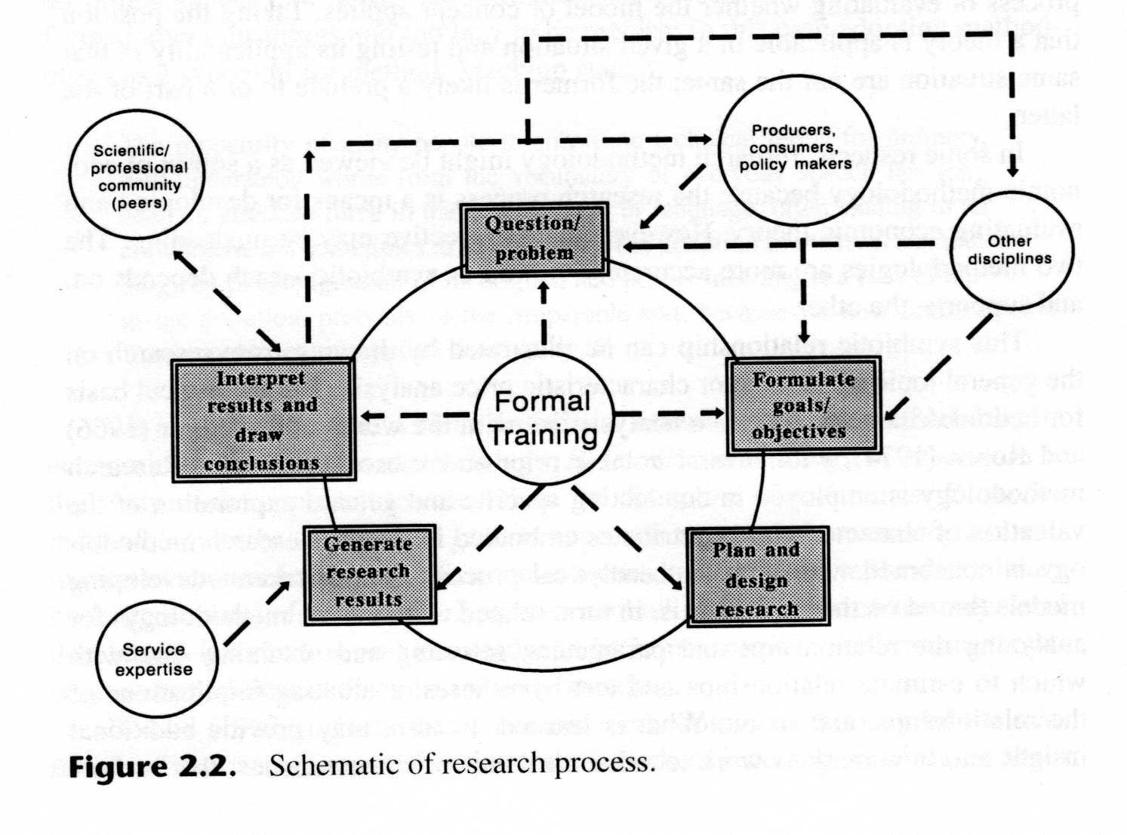
The Process of Research

Slide 15
Research article writing
Find suitable/specified journals
Get copy of Instructions to authors
Prepare article as per instructions
Select suitable titles
Authors and affiliations
Abstract
Highlights
Novelty statements
Introduction
Materials and methods
Results and discussion
Conclusions
Acknowledgements
References

Slide 16
Authorship/ethics
All authors should directly involved in entire study
Article is free from plagiarism
Should follow ethics

Slide 17
A Research Report
A Research Report generally include:
  Introduction and Statement of problem
  Review of relevant literature
  Statement of hypothesis or research objectives
  Theoretical resume
  Description of research design
  Description Experimental design
  Description of measurement and data analysis
  Error compounding
  Presentation of Results
  Discussion
  Conclusion, limitations, and implications
  Suggestions for future work
  Acknowledgements
  References cited
  Appendices

Slide 18
Types of research
1. Application- Pure and Applied Research
Applied- Finding solutions for immediate problems facing a society/industry
Pure- Concerned with generalization and formulation of a theory
2. Inquiry Mode- Quantitative and qualitative
Quantitatative- Measurements of quantity or amount
Qualitative- Concerned with qualitative phenomena (reasons for human behavior)

Slide 19
Research Studies
Based on research objectives:
Exploratory or formulative research- To gain familiarity with a phenomenon or to achieve new insights into it
descriptive research- To study accurately the characteristics of a particular individual, situation or a group-includes survey

Slide 20
Research Studies
Diagnostic research- To determine the frequency with which something occurs or with which it is associated with something else
hypothesis-testing research- To test a hypothesis of a causal relationship between variables

Slide 21
Thank you

